Slide 1
Connecting to MySQL Server

Slide 2
How to Connect to MySQL Server
From MySQL Workbench
From Eclipse
From jGrasp
From Linux Machine

Slide 3
From MySQL Workbench
Two Cases
  If you are using an on-campus machine
  If you are using your own laptop

Slide 4
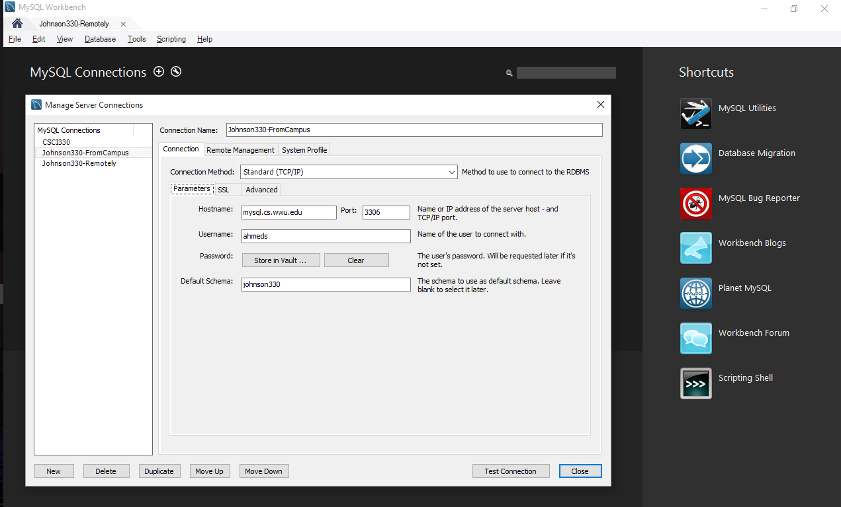
From On-Campus Machine
Your Username and Password

Slide 5
From Laptop
At first, we need SSH Tunneling
Why need SSH Tunnel and how SSH Tunnel works?
Tutorial @ Western
  https://support.cs.wwu.edu/index.php/Tunneling_MySQL_ports_through_SSH
Run PuTTY

Slide 6
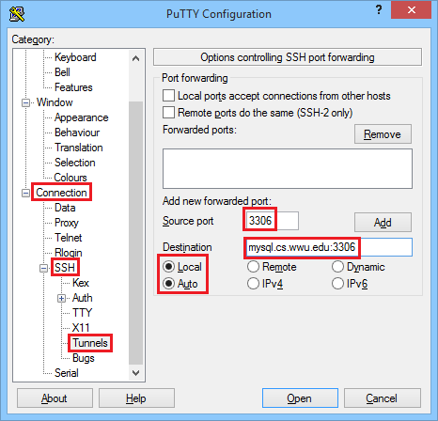
Setting up the tunnel
Note:
Use separate Source
Port number (e.g. 4321) if this port is already being used by MySQL server in your computer.

Slide 7
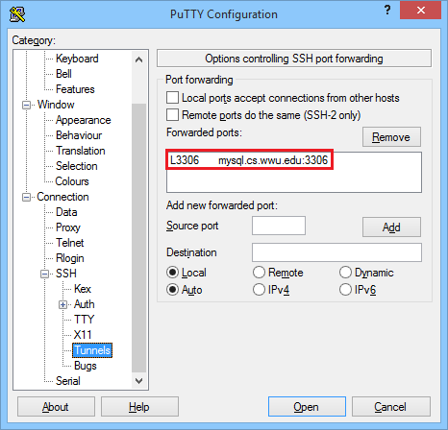
Setting up the tunnel

Slide 8
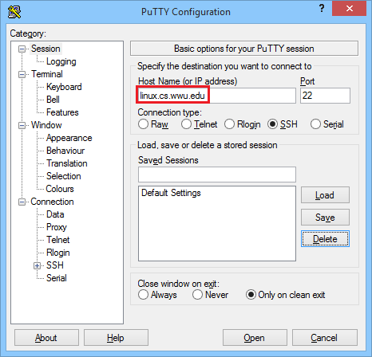
Saving the Session
Should be 922

Slide 9
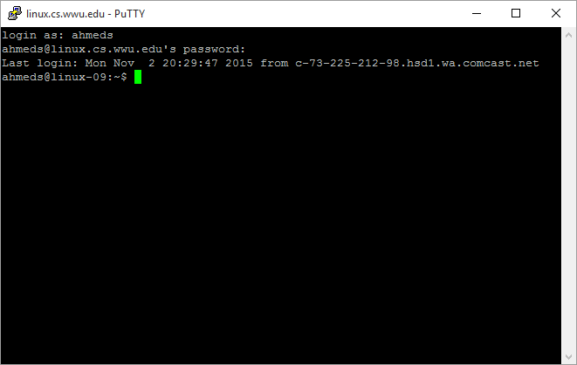
Use your regular username and password here (which you use to log in to on-campus machine)

Slide 10
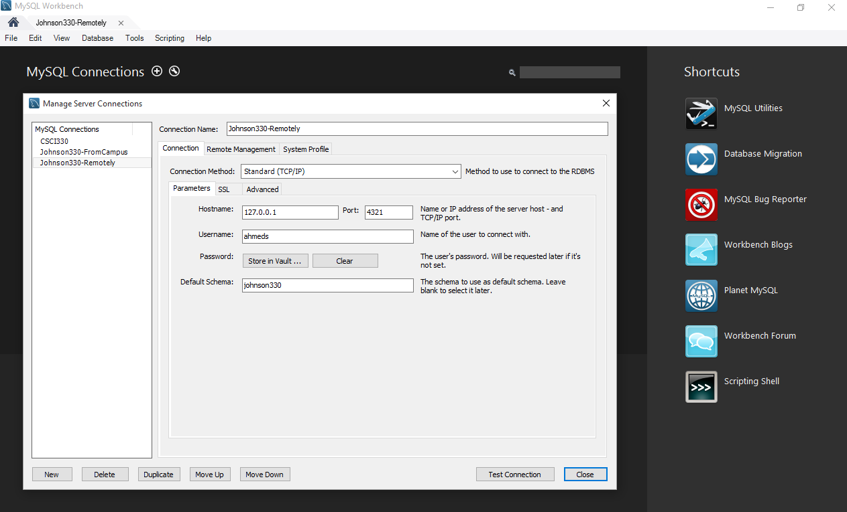
Now Connecting From MySQL Workbench

Slide 11
How to Connect to MySQL Server
From MySQL Workbench
From Eclipse
From jGrasp
From Linux Machine

Slide 12
Jar file
Make sure that jar file (mysql-connector-java-5.1.36-bin.jar) is available in the machine.
  If not, download from Internet.
In my laptop, the location is:
C:\Program Files (x86)\MySQL\Connector.J 5.1\mysql-connector-
java-5.1.36-bin.jar

Slide 13
Include jar file in Classpath
Select the project.
In the toolbar at the top, click the down-arrow next to the green run-button.
Click Run Conﬁgurations.
Double click the Java Application entry to get a new run conﬁguration for your project.
The project line will be ﬁlled in, but you should complete the Conﬁguration Name entry at the top.
Click the Classpath tab, select Bootstrap Entries, then click Add External JARs.
Navigate to your MySQL Java connector ".jar" ﬁle, select it, and click Open.
Finally, click Apply and Close to add the connector to the project classpath.

Slide 14
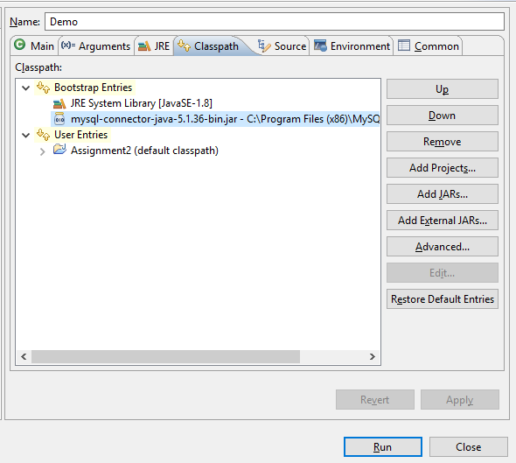

Slide 15
From On-campus machine
Connection parameters (e.g. ConnectionParameters.txt)
  dburl=jdbc:mysql://mysql.cs.wwu.edu/johnson330
  user=your userid goes here
  password=your password goes here
Explanation of dburl:
  jdbc:mysql – This requests a connection to a MySQL database.
  //mysql.cs.wwu.edu – This is the name of the server.
  johnson330 – This is the name of the database on the server

Slide 16
From Laptop
First Setup SSH Tunnel
Connection parameters (e.g. ConnectionParameters.txt)
  dburl=jdbc:mysql://127.0.0.1:4321/johnson330
  user=your userid goes here
  password=your password goes here

Slide 17
How to Connect to MySQL Server
From MySQL Workbench
From Eclipse
From jGrasp
From Linux Machine

Slide 18
Include jar file
Create a separate directory for the assignment.
Open jGrasp.
In jGrasp, click New on the Project menu.
Fill in the name of your project (something like Assign2) and save it in your directory for the assignment. When you want to restart this project, double click the .gpj file (for example, Assign2.gpj) to open jGrasp, or use the Open item on the Project menu to open the project.
Use the Add Files item on Project menu to add any source files and other files you might want to edit to project. They will appear in the window at the bottom left of the jGrasp window.
Finally, before you run your program, click on the Setting/PATH CLASSPATH/Project menu item.
Click the PATH tab and then the CLASSPATHS tab under the PATH tab.
In the CLASSPATHS tab, click New. In the resulting dialog, click Browse for "Path or JAR file". Now "open" the MySQL Java connector JAR file.
Click OK until you've exited the dialogs.

Slide 19
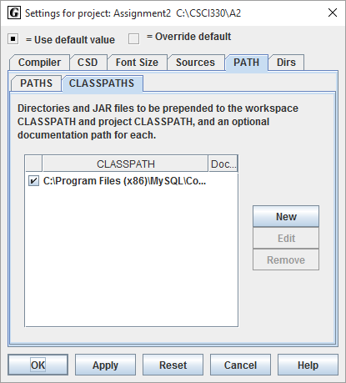

Slide 20
ConnectionParameters.txt
From on-campus machine
  dburl=jdbc:mysql://mysql.cs.wwu.edu/johnson330
  user=your userid goes here
  password=your password goes here
From laptop (First Setup SSH Tunnel)
  dburl=jdbc:mysql://127.0.0.1:4321/johnson330
  user=your userid goes here
  password=your password goes here

Slide 21
How to Connect to MySQL Server
From MySQL Workbench
From Eclipse
From jGrasp
From Linux Machine

Slide 22
From Laptop
Set up a SSH Tunnel
  Open a Terminal
  Type
    ssh -p 922 -L 4321:mysql.cs.wwu.edu:3306 username@linux.cs.wwu.edu
Connection parameters for Java Programming(e.g. ConnectionParameters.txt)
  dburl=jdbc:mysql://127.0.0.1:4321/johnson330
  user=your userid goes here
  password=your password goes here

Slide 23
From On-Campus Machine
Connection parameters for Java Programming(e.g. ConnectionParameters.txt)
  dburl=jdbc:mysql://mysql.cs.wwu.edu/johnson330
  user=your userid goes here
  password=your password goes here

Slide 24
How to Connect to MySQL Server
From MySQL Workbench
From Eclipse
From jGrasp
From Linux Machine

